Slide 1
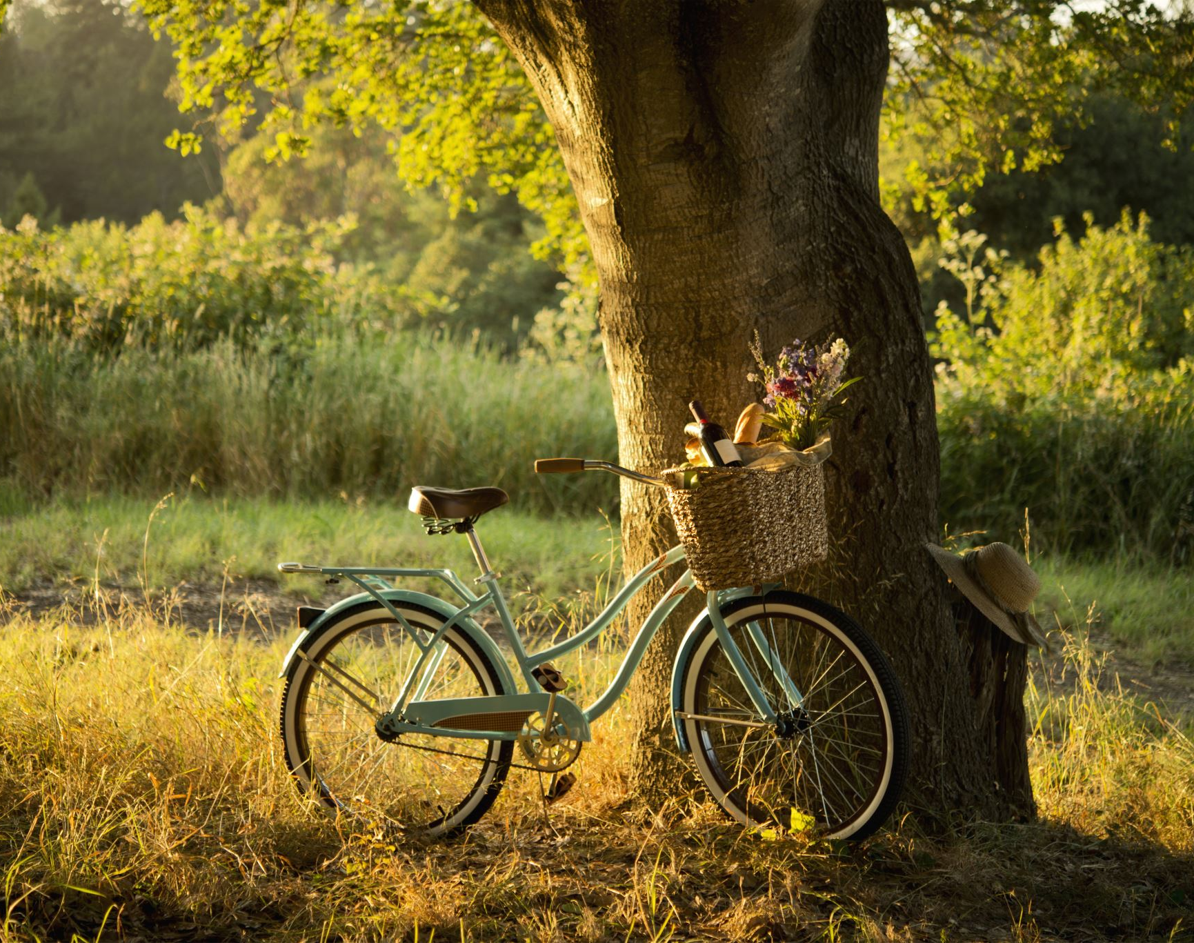
Insights on Bay Wheels by Nikhil Isaac Manohar
Agenda:
Demand Prediction
Optimizing Operations
Couple Bikes business proposal
Conclusion

Slide 2
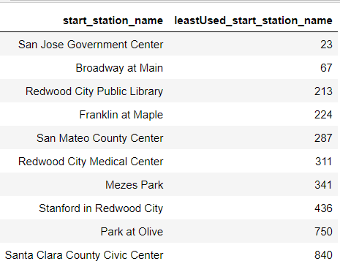
Demand Prediction
Demand Prediction
10 most least popular stations used by travelers.
Along with least popular , we also calculated stations which were very close to each other using Haversine approach and we could see out of the 10 Least most popular stations,
‘Redwood City Public Library’ and ‘Franklin at Maple’ are very close as well as not so popular
‘Franklin at Maple’ and ‘San Mateo County Center’ are very close as well as not so popular
‘Redwood City Public Library’ and ‘San Mateo County Center’ are very close as well as not so popular.
Therefore, the stations we recommend to be discontinued are,
Redwood City Public Library
Franklin at Maple
San Mateo County Center

Slide 3
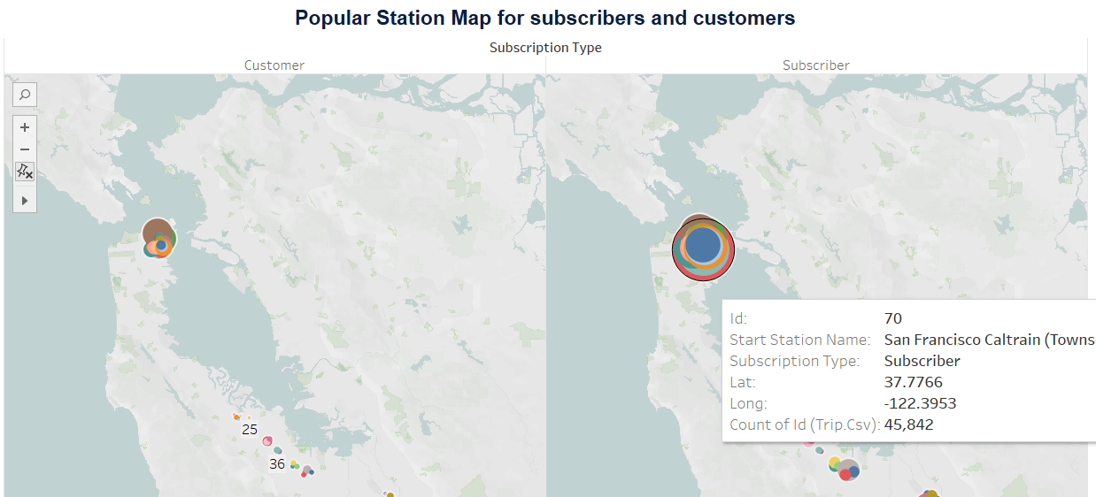
Optimizing Operations
Optimizing Operations
We can see which are the most popular areas and through tableau map for customer & subscriber, we could see how popularity varies. To optimize and get more profits we could increase the avg available bikes at most popular areas one such,
Example is id = 70 (San Francisco Caltrain (Townsend at 4th)) this station is one of the most popular among subscribers, at this station we can increase avg available bikes

Slide 4
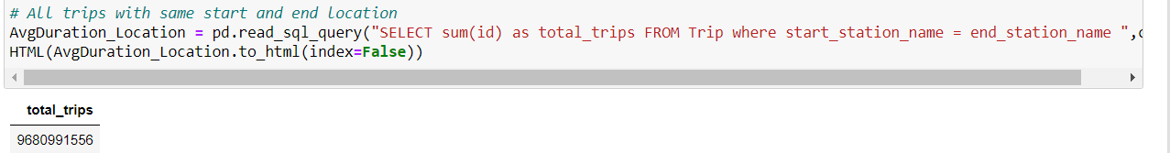
Couple Bikes business proposal
Factors to consider for validating the possibility of couple bike are,
Factor-1: If Start Station Name and End Station Name are same.
Target above areas which had same start and end location these area had total 9,68,09,91,556 trips out of 3,08,43,70,70,970 trips in 3 years that is around 3 % of trips with same start and end location.
Factor-2: Target the most popular areas as these areas will mostly be from where working professionals, students etc. will travel.
Target Areas such as,
1. College/University from nearest metro stations
These are the areas which will have same start and end between college/university to metro vice versa.
2. IT Tech parks / Hospitals / Major Bank Branches to nearest Metro Stations
These area are also those can be busy 24 hrs. as they function 24hrs due to there work culture and since crowed travelling to & fro from metro stations to these areas is more frequent, its one of the best location to tackle
3. Lastly Grocery/hypermart/Supermarket such as Walmart to the nearest housing society/flats/apartment residential areas. These are very good location which will target all group of people, since it involve day to day basic shopping

Slide 5
Factor-3 : Cost when 2 person travelling in single bike must be less than the cost that 2 individual bikes would have cost
Cost for transportation is one of the main factors that every individual compares while opting the best options available in public transport
At the very least, an individual cost while in couple travel must be less than 25%. Because this % shall give individual 25 % and Bike company will get 50%.
Let's say P1 and P2 are two individual who are travelling same destination, in normal situation it will cost them X amount each respectively i.e., 2X in Total and lets also assume travel cost of bike for bike company also as 2X.
Now if travelled in couple bike with 25% discount P1 and P2. Total cost would be 1.5X (0.75X each) and let’s say travel cost of bike for bike company as X (assuming same amount from above for single bike), then we clearly see that profit for bike company also is 50%.
Note: Factor 2 & 3 cannot be completely accurate/validated since these are just formulated on based market needs that we all see day to day. Also, the above data does not contain any such column through which we can check Cost or specific locations related to metro stations/universities/Markets
Factor-4: Least most Popular area
We must avoid those regions/stations which are least used

Slide 6
Conclusion
Two main parameters to be considered while deciding couple bikes idea,
1. Location:
a. Best fit stations – Most popular stations.
b. Wort fit stations – Least popular stations(to avoid).
c. Stations near Universities/Markets/Metro Stations/IT Tech Parks/Hospitals
2. Cost/Price point for customers such that it is win-win situation for all

